Slide 1
CSS Layout
Mr Mack 2021

Slide 2
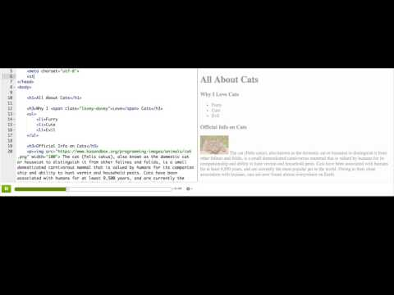
CSS grouping elements

Slide 3

Practice: Group the groupers
This webpage describes groupers, a type of large ocean fish. In the first step, your job is to to make the first sentences of each paragraph stand out. Start by adding <span> tags around each first sentence. Then give both of your <span> tags a class called "first-sentence".
Add spans

Slide 4
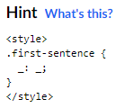
Practice: Group the groupers
Good! Now, using a class selector, write a CSS rule to style your "first-sentence" class. Make the sentence either bold, or underlined.
Style Spans

Slide 5
Practice: Group the groupers
Great! Wrap the paragraphs in a single <div>, and then give the div a class of "info".
Add a div

Slide 6
Practice: Group the groupers
Last step! Using a class selector, write a CSS rule to style your 'info' class. Give it a cool looking background color.
Style the Div

Slide 7
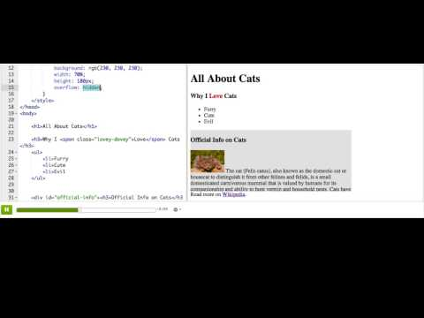
CSS width, height, and overflow

Slide 8
Practice: The overflowing ocean
This webpage describes the ocean, with an image and a few paragraphs which are inside a <div>.
In this first step, style the <div> that has a class of 'info', so that it takes up 70% of the width and is 200px tall.
Resize the div

Slide 9
Practice: The overflowing ocean
Now, make it so the div cuts off the overflowing text and presents a scrollbar instead.
Make it scroll

Slide 10
Practice: The overflowing ocean
In this last step, write a CSS rule for the ‘pic’ class that resizes the image to take up the same width as the text.
Resize the img

Slide 11
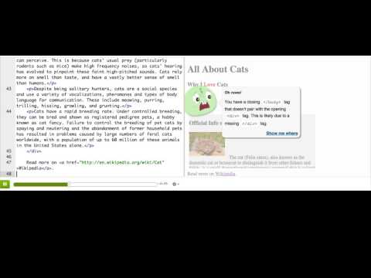
CSS box model

Slide 12
Practice: The boxer model
This webpage displays a gallery of photos of boxer dogs. In this first step, add a border to all of the photos. Try and make it look like a photo frame, if you can.
Add borders

Slide 13
Practice: The boxer model
The photos look a bit too close to each other. Add margin to them, either on all sides or just the sides that matter to separate them.
Add margin

Slide 14
Practice: The boxer model
The photos are too close to the side of the gallery div, and it looks weird. Add padding around all sides of the gallery div so that it looks better.
Add padding

Slide 15
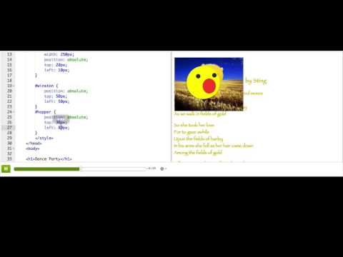
CSS position

Slide 16
Practice: Position planet
This webpage contains an image of a planet, an image of a creature, and a div with a greeting. Your job is to make it look like the creature is sitting on the planet and saying the greeting. In this first step, use absolute positioning to put the creature on top of the planet somewhere.
Position the creature

Slide 17
Practice: Position planet
In this second step, position the greeting on top of the planet as well.
Position the greeting

Slide 18
Practice: Position planet
Now use a z-index property to make sure that the greeting always shows up over the creature, not behind.
Order them

Slide 19
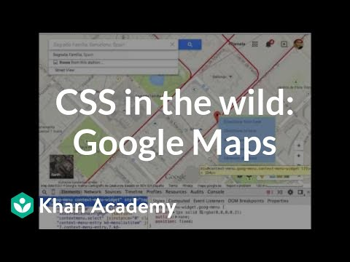
CSS in the wild: Google Maps

Slide 20
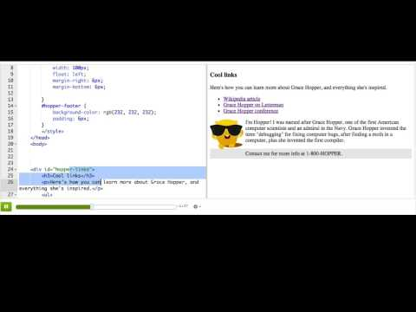
CSS floating elements

Slide 21
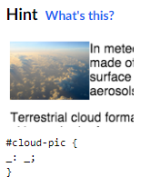
Practice: Floating clouds
This webpage contains information on clouds plus a photo of clouds. In the first step, float the photo to the left of the text, so that the text wraps around it.
Float the photo

Slide 22
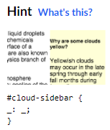
Practice: Floating clouds
There's a yellow div of information. Make that div float to the right of the text, so that the photo is on the left side of the text and the yellow div is on the right side of the text.
Float the sidebar

Slide 23
Practice: Floating clouds
Now that we have elements floated next to each other, we should make sure to separate them with some whitespace. Add appropriate margins to the photo and the sidebar.
Add margins

Slide 24
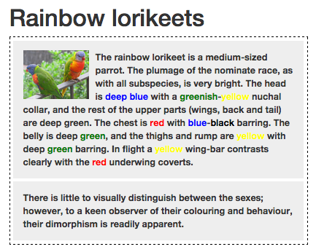
In the webpage shown below, what tag is the best option for the bordered element that surrounds the two paragraphs?
<p>
<table>
<div>
<span>
Notes:
🍐 This is a Pear Deck Multiple Choice Slide. Your current options are: A: A, B: B, C: C, D: D,
🍐 To edit the type of question or choices, go back to the "Ask Students a Question" in the Pear Deck sidebar.
C

Slide 25
In the webpage shown below, what tag is the best option for the styled color names in the paragraph ("blue", "greenish", "red", etc)?
<div>
<font>
<span>
<p>
Notes:
🍐 This is a Pear Deck Multiple Choice Slide. Your current options are: A: A, B: B, C: C, D: D,
🍐 To edit the type of question or choices, go back to the "Ask Students a Question" in the Pear Deck sidebar.
C

Slide 26
Planning your webpage
How can you turn a blank page into the webpage of your dreams? You could just start writing HTML and CSS—changing things along the way, removing things you don't like, adding things you suddenly think of, and rearranging parts of the page.
That's not always the best strategy, however, as it can lead to a lot of wasted time writing HTML and CSS that you later discard. Instead, you should plan your webpage before you actually build it. You can figure out content, layout, and even the look and feel.

Slide 27
Brainstorming
The first step of planning anything is often brainstorming—figuring out anything and everything you might want to do. You brainstorm by drawing mind maps on paper, jotting notes in a document, or by putting post-it notes on a board.
You can brainstorm by yourself or—if you want to multiply the range of ideas—enlist a collaborator to brainstorm with you. While you're brainstorming with a collaborator, use the "Yes, and…" approach. Don't focus on what won't work about your collaborator's ideas; focus on what might work and which related things might work.
After you generate lots of ideas, you'll need to decide which ones you actually want to pursue. Prioritize the ones you're most excited about—try starring them or moving them into a list—and discard the rest or save them for later.

Slide 28
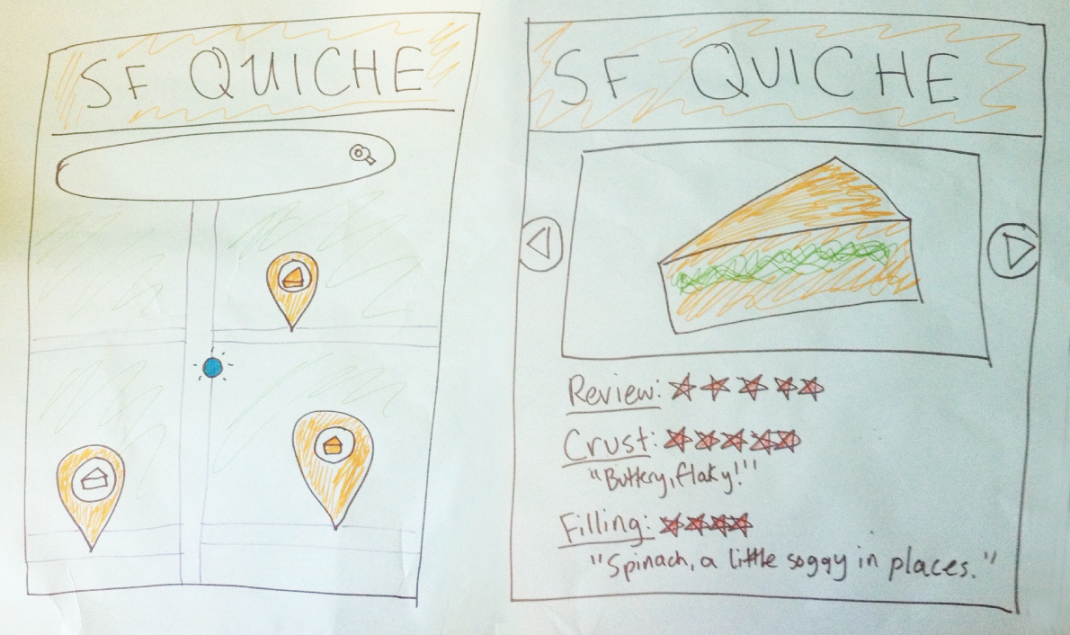
Paper prototyping
A good next step is to create a paper prototype—your webpage, but on paper. It's a sketch of the components of your webpage, with scribbles for content and boxes for elements.
Below is a paper prototype for SF quiche, a web app that will satisfy all your quiche-finding needs:

Slide 29
Paper prototyping
Since it doesn't take much time to make a paper prototype, you can iterate quickly and not feel too stuck to your original design. You can also make a few different prototypes at once, and you can make prototypes for multiple pages of your site.
After you've made a prototype, you might want to do some user testing. Show the prototype to a friend, then ask them what they'd click first or where their eyes travel to. See if they have any other feedback.

Slide 30
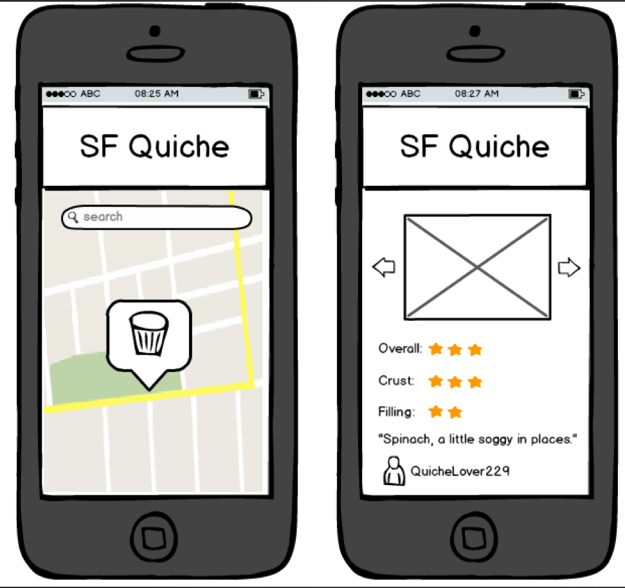
Wireframes
Once you're feeling pretty good about your paper prototypes, you might want to turn them into wireframes. A wireframe is like a prototype, but it's typically digitally drawn and more precise. A wireframe is made up of boxes that represent each part of a page, plus small bits of text and icons as needed. For example, below is a wireframe of our SF quiche app:
Notes:
This wireframe was created in a popular online prototyping tool called Balsamiq. You can also make wireframes using the shape tools in office tool—like Powerpoint/Keynote—or by using design apps like Photoshop, Gimp, or InDesign. You can also search for more prototyping tools online. Keep in mind that many wireframing apps cost money when you're deciding which to use.
Once you've made your wireframes, you might want to do another round of user testing. Some wireframing tools let you share your wireframes for others to comment on. There are also tools like InvisionApp that let you create interactive wireframes, where clickable areas lead to new screens

Slide 31
Challenge: Event invite
In this challenge, you'll make an event invite for an event- a party, a workshop, a wedding, whatever you want. It should have event title, details, and maybe it'd have a guest list or RSVP button.
Before you start coding, I encourage you to "prototype" it - to plan it out either on paper or with a "prototyping" tool. Sketch out the vision you have in your head and go through a few prototypes until you're happy.
Then, when you're ready, try to implement your event invite in HTML/CSS. If you get stuck on something that's hard to transfer from paper to HTML, try searching on the internet or clicking "Request Help." I bet you'll learn something from the process.

Slide 32
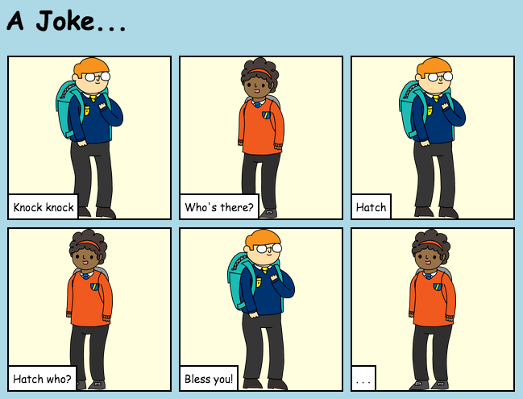
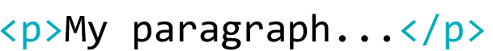
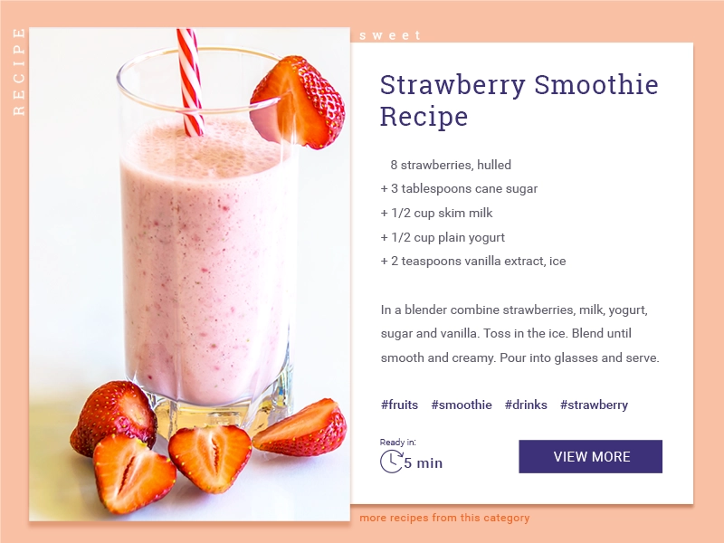
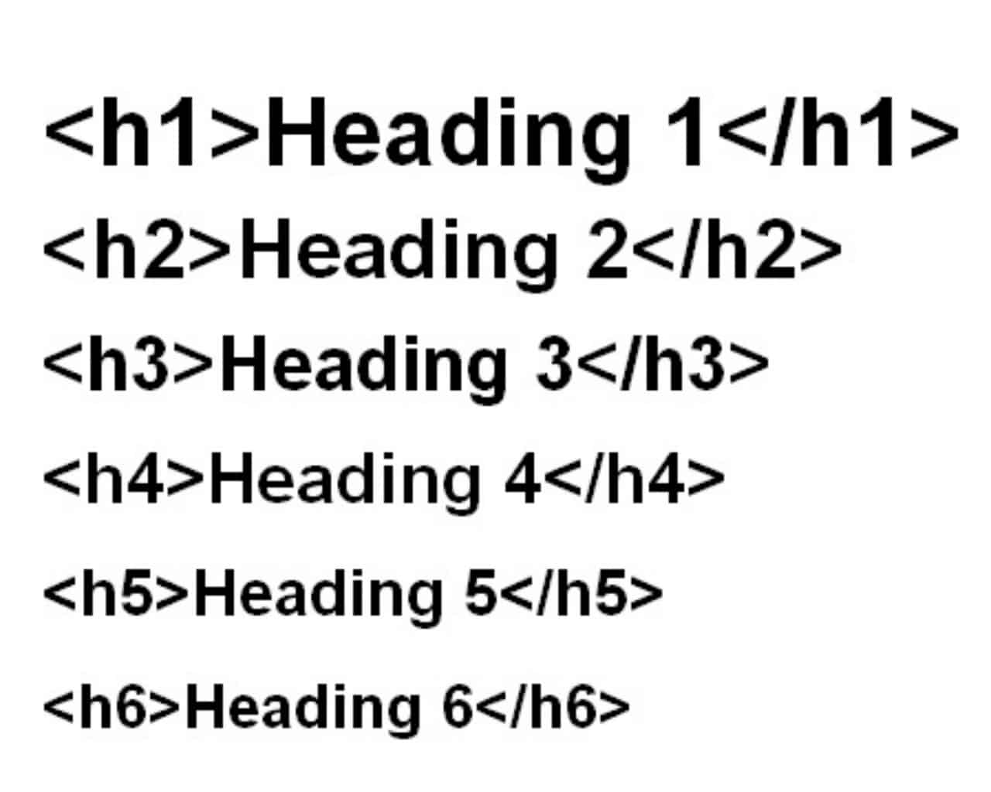


TELL A STORY
START HERE
CREATE YOUR OWN STORY USING HTML AND CSS!
Open the link Tell A Story task
Edit the code and create your own story.
In this activity, you make your own poster. You will use the html and css.
Here’s a list of code you will need:
How to insert an image:
How to insert a paragraph
How to insert a heading:
How to insert a new box for the next part of the story
FINISHED?
Submit your story on Google classroom.
Challenge yourself! Edit the CSS, change the background colour (remember hex colour codes), the font bit.ly/cssfonts
Help a neighbour!
Credit to Code Club projects for this activity.
Notes:
Pupils will be introduced to <divs>. Div is short of division, and is a way of grouping stuff together. I wouldn’t get further into <div> tags with S1/2 but this is a fun and engaging task that pupils enjoy and allows pupils the opportunity to put into practice the knowledge they have learnt over the previous lessons. I would open the task and show them how to make a new box etc. this is a good point again to ask pupils about any useful keyboard shortcuts they could use, particularly if the class has done the digital shortcut lesson etc. If not I usually show them copy and paste shortcut to make it easier.
Common mistakes I have found pupils do is they copy and paste the code but inside previous code, so I usually show them this and show emphasis the importance of order again and that each section should be under the finished section etc. but also that the last thing should be the closing </html> tag. It might also be useful to ask the class how to insert an image. This is useful to check for understanding but also to remind pupils who may have forgotten how to do this. TASK
Pupils will be tasked with making a comic strip, this can be about anything they as long as it’s appropriate. OBJECTIVES
By completing this activity, students will:
Become more familiar with editing html.
Become more familiar with editing css.

Slide 33

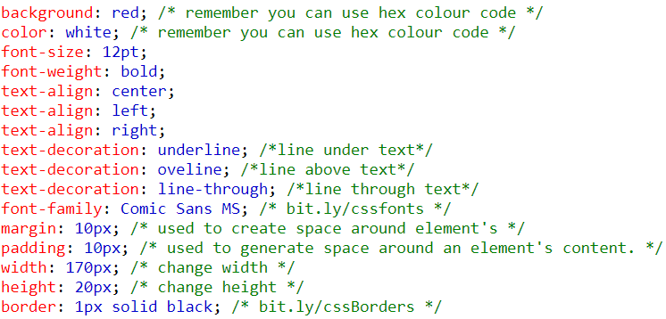
WANTED POSTER!
CREATE YOUR OWN POSTER USING HTML AND CSS!
START HERE
Open the Poster tasks
Edit the code to make your own poster.
In this activity, you make your own poster. You will use the html and css.
Here’s a list of some CSS properties you can use:
FINISHED?
text-decoration: overline;
Publish your poster on Google classroom.
Help a neighbour!
Challenge yourself! Research how to add a link to a website or insert a YouTube video.
Credit to Code Club projects for this activity.
Notes:
I would open the task and demonstrate some of the changes they could make to the format of the page using the css properties show on the slide. Common mistakes seem to be pupils missing - or ; or spelling such as colour instead of color etc. So I would try to preempt these potential errors and deliberately make common errors that I may have seen in previous lessons etc and see if anyone in the class can spot what they are and how to fix them.
TASK
Pupils will be tasked with making their own poster. I would always encourage pupils to be creative and say it doesn’t have to be a wanted poster, it could be a poster for a gig, a movie, an event etc.
OBJECTIVES
By completing this activity, students will:
Become more familiar with editing html.
Become more familiar with editing css.

